Slide 1
Coding Challenges and Loops
CodeSLO, LLC 2018

Slide 2
Intro to Fullstack Coding Challenges

Slide 3
The Fullstack Academy Coding Challenges
Fullstack Academy has provided us with a series of coding challenges to help you build the skills they are looking for from new students.
They’re good challenges, and written using a tool called Jasmine, a testing suite used in Test Driven Development.
The idea of TDD is basically this: Software testers write a script that looks for expected output from a function. Developers write a function, and it often fails one or more tests. Developers then debug their function until it passes all tests, showing that they have a dependable function. The process repeats until a full application is ready for production.

Slide 4
But first...
Before we tackle our first set of Fullstack Coding Challenges, we have a few concepts to go over.
Array.splice
Else If
Greater Than and Less Than operators
Typeof

Slide 5
Array.splice
We won’t go over every single array method today, but we still need to talk about a couple more, starting with splice.
Splice (like pop) is an interesting method in that it both does work and returns a value. Like push and pop, splice modifies the array it is called on, (not all array methods do, btw) but splice also returns a value of the items it removed.

Slide 6
Array.splice (cont)
Array.splice is a bit like pop in that it removes index items, but unlike pop it can remove more than one. To use splice you have to pass it the index number to start the splice at, as well as the number of items you want spliced away.
let myArr = [0,1,2,3,4,5,6];
// splice out index positions 3 and 4
let splicedOut = myArr.splice(3,2); // start at index three, remove two items

Slide 7
Exercise: Splice it up
Create a new file called spliceMe.js
Add an array: [‘classical’,’rock’,’hiphop’,’country’,’reggae’]
Create a function that you can pass your array to
Your function should return your two favorites from that music genre. Use Array.splice to accomplish this. You can use multiple splices to accomplish this, but your function should return only one array!

Slide 8
Else if
We learned about if/else statements in an earlier class.
Else if just allows us to chain multiple, related if statements together.
Imagine we wanted to wanted to order a certain kind of sandwich.
If the deli has ham, we’ll take that.
If they don’t have ham, we’ll take turkey
If they don’t have ham or turkey, then we want roast beef.

Slide 9
Else if example
if (hasHam) {
return 'I want a ham sandwich';
} else if (hasTurkey) {
return 'I want a turkey sandwich';
} else {
return 'I guess I\'ll have roast beef, then'; // the backslash is an escape character that allows us to use the single quote in a string without terminating the string.
}

Slide 10
Exercise: if/else if /else
Create five variables, each named for something you might want to buy at a store. Give each variable a boolean value of your choice.
Create an if/else if/ else statement that checks the value of each variable. If one is true your app should log “I bought a “ + variableName
Experiment with changing the values of your variables, changing true to false or false to true. Run your app with the changed values and see what happens.
See elseIf_example.js for an example of an if/else if/else statement

Slide 11
Greater Than / Less Than
We can use the > and < comparison operators to generate a boolean value. This can be very useful in if/else statements and for loops (more on those later.)
console.log(5 > 3); // logs true
console.log(12 < 6); // logs false

Slide 12
Greater than / less than in an if/else
let val_01 = 15;
let val_02 = 10;
// logs the larger value
if(val_01 > val_02){
console.log('val_01 is the larger value');
}else{
console.log('val_02 is the larger value');
}

Slide 13
Greater than / less than, or equal to
Greater and less than operators are exclusive of equal values.
console.log(5 > 5); // logs false
However, we can also use the >= and <= operators to be inclusive of equal values.
console.log(5 >= 5); // logs true

Slide 14
Typeof
Typeof is an operator that shows the data type of a variable.
console.log(typeof 42); // logs number
console.log(typeof "Hello"); // logs string
console.log(typeof false); // logs boolean
console.log(typeof function(){}); // logs function

Slide 15
Typeof: Weird cases
console.log(typeof undefined); // logs undefined
console.log(typeof [1,2,3,4]); // logs object :(
console.log(typeof null); // logs object
console.log(Array.isArray([1,2,3,4])); // logs true

Slide 16
Array.isArray
As you can see, typeof is not useful for identifying arrays.
If you want to check if a variable is of the array type, you need to pass that variable to the Array.isArray method.
console.log(Array.isArray([1,2,3,4])); // logs true

Slide 17
Exercise: Typeof
Create variables of the following types: string, number, boolean, function, array, and undefined.
Use console.log and typeof to see the type of each variable
Check your array variable using Array.isArray(yourVarHere);

Slide 18
Time to check in!

Slide 19
Fullstack Coding Challenges

Slide 20
Intro to Coding Challenges
Fullstack Academy has provided us with a variety of coding challenges that are meant to prepare you for their admittance test.
As an additional benefit, doing these challenges will teach you about coding tests, and the Jasmine testing framework.
Let’s check them out! Go to
https://codepen.io/codeslo/collections

Slide 21
Fork these challenges
No, seriously. Create a CodePen account, and use the fork button to move them to your account. Then you can revisit them, save answers or answers-in-progress, etc.

Slide 22
Exercise: Complete the FS Practice Coding Challenges
If you get stuck, remember to follow the CodeSLO getting stuck procedure!

Slide 23
Take a break. Back in Five...

Slide 24
Loops

Slide 25
For Loops
One thing that computers are very good at is repeating a series of instructions accurately at almost unthinkable speeds.
As programmers, one of the ways we use this functionality is via loops.
One of the basic types of loops is the for loop.
Let’s write one.

Slide 26
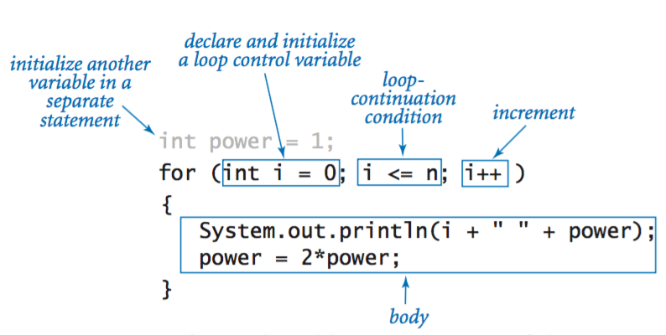
Anatomy of a For Loop

Slide 27
For Loop Example
// a loop that counts to twenty in the console
for(let i = 1; i<=20; i++){
console.log(i);
}

Slide 28
To infinity… and beyond!
One thing to watch out for with any kind of loop is the accidental creation of an infinite loop.
A loop must always have an achievable exit condition.
// running this code will crash the environment
for(let i = 0; i < 10; i--){ // do you see the problem?
console.log(i);
}

Slide 29
Exercise: Count by twos
Create a for loop that logs all the even numbers between 2 and 100 to the console.
Use the modulo (remainder) operator to test for even values.

Slide 30
Descending For Loops
Creating a descending for loop is just a different way of using a for loop. Instead of counting up, you count down.
// counts down from 20 to 0
for(let i = 20; i >= 0; i--){ // note the i--. i++ would give us an infinite loop!
console.log(i);
}

Slide 31
Iteration
Probably the most common use of the for loop is to iterate through arrays.
let myArr = ['JavaScript','is','awesome','!!!'];
// a for loop that iterates through myArr and logs each element
for (let i = 0; i < myArr.length; i++){
console.log(myArr[i]);
}

Slide 32
Exercise: onlyOdds
Create a new file called onlyOdds.js
In onlyOdds, create an empty array called result
Using a for loop, push all the odd numbers between 1 - 1000 into the result array.
Log the result array.
Log the length property of the result array.
Log an array made up of all the elements in the result array with a value between 30 and 70.
Log an array made up of the last ten elements of the result array

Slide 33
Want more coding problems? (Spoiler alert: yes, you do)
A great site to go to for coding problems is Coderbyte.
In software, programming interviews often feature coding challenges. You’ll want to be good at them!
You’re at a point now where you can start doing basic ones. They will probably be hard, at first.
In fact… they’re always kind of hard. That’s the point.
Try to do at least one Coderbyte challenge per day. If you get stuck, check Google, Stack Overflow, and the CodeSLO Cohort slack channel.

Slide 34
Questions?

Slide 35
Coming Up
Tomorrow we’ll go over debugging. We’ll teach you ways to quickly find and fix errors in your code.
We’ll also have more exercises with loops and arrays while we prepare for another set of Fullstack Academy coding challenges.
This is the part of our curriculum where people often feel frustrated. It’s okay to feel that way, but you’re doing great! Remember, this is all part of a process.
Tenacity is talent!

Slide 36
Code on!

